Slide 1









Robust M-Estimation Based SVM
for Improving Binary Classification
이중 분류 성능 향상을 위한 강건한 M-추정 기반 SVM
김민경, 유지아, 윤진희
Min Kyung Kim, Jia Yoo, Jin Hee Yoon
Department of Mathematics and Statistics, Sejong Univ., South Korea
한국지능시스템학회 2025 춘계학술대회

Slide 2

1. Introduction
• Support Vector machines(SVMs) are widely applied in classification problems;
here, we focus on binary classification.
• Key strengths:
- Strong generalization, even with small datasets
- Flexible via kernel functions
- Guarantees global optimum (quadratic programming)
02

Slide 3
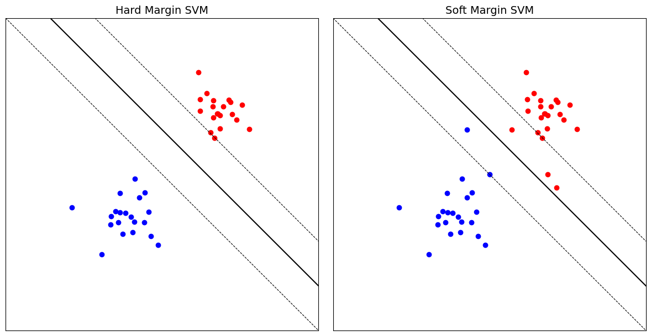



1. Introduction
Types of SVMs
• Hard Margin:
$\min{\frac{1}{2}{\left\|w\right\|}^{2}}$
$$s.t. y_{i}\left(w^{T}x_{i}+b\right)≥1$$
all samples must be correctly separated
$→$ very sensitive to outliers
• Soft Margin:
$\min{\frac{1}{2}{\left\|w\right\|}^{2}+C\sum{ξ_{i}}}$
$$s.t. y_{i}\left(w^{T}x_{i}+b\right)≥1−ξ_{i}$$
allows some error
$→$ expressed via slack variables $ξ_{i}$
$$ξ_{i}$$
$$ξ_{i}$$
03

Slide 4
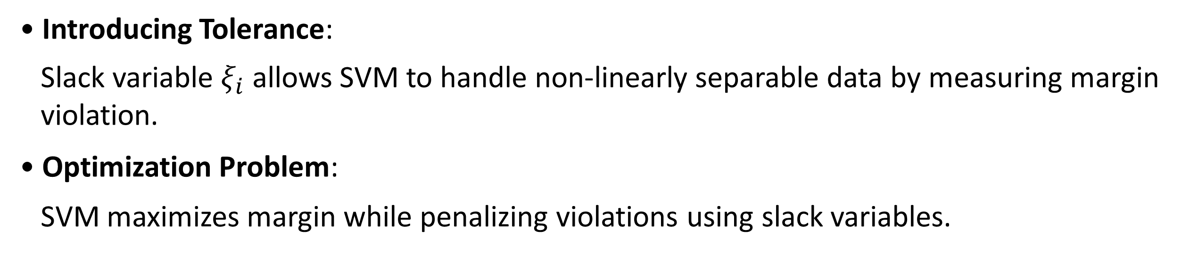
2. Limitations of Traditional SVMs
Role of Slack Variables $ξ_{i}$
• Introducing Tolerance:
Slack variable $ξ_{i}$ allows SVM to handle non-linearly separable data by measuring margin
violation.
• Optimization Problem:
SVM maximizes margin while penalizing violations using slack variables.
04

Slide 5
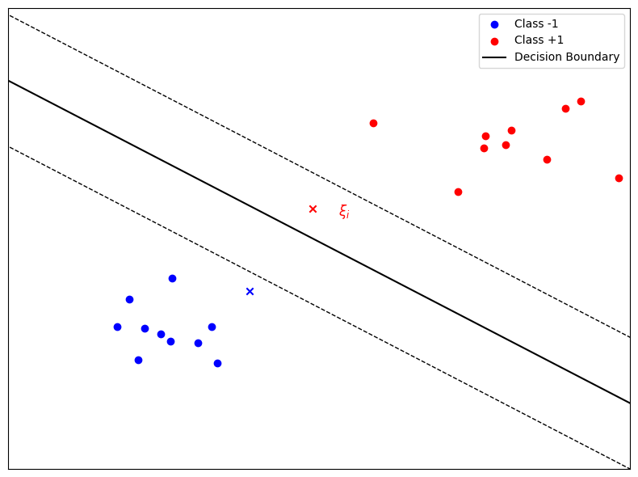



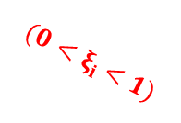
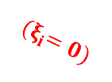
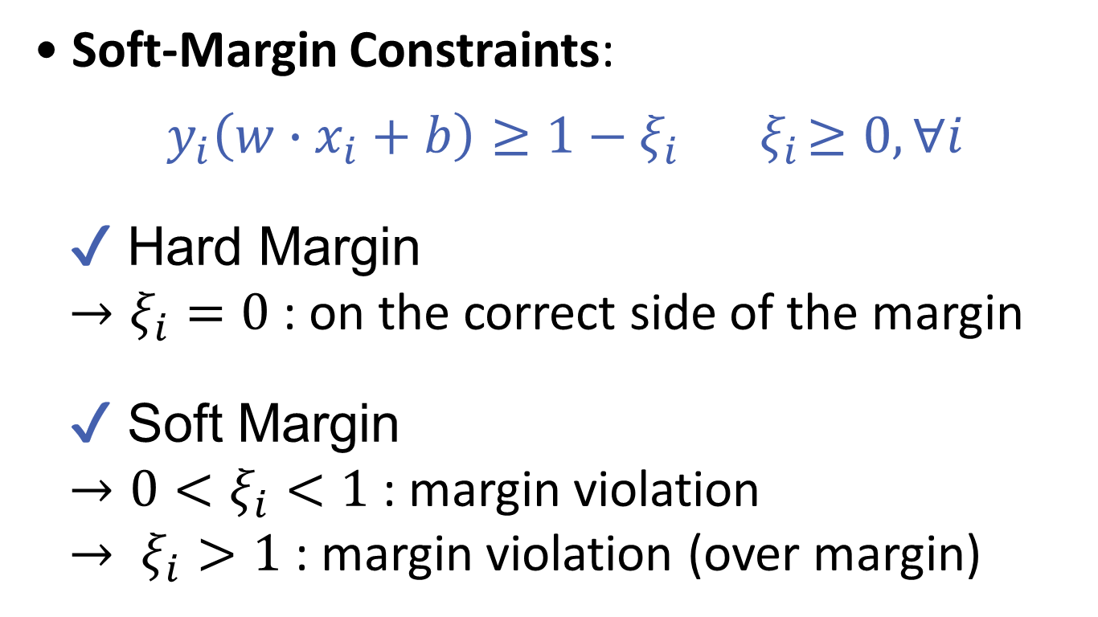
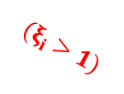
2. Limitations of Traditional SVMs
Role of Slack Variables $ξ_{i}$
• Soft-Margin Constraints:
$$y_{i}\left(w∙x_{i}+b\right)≥1−ξ_{i}{ ξ}_{i}≥0, ∀i$$
✔ Hard Margin
$→ξ_{i}=0$ : on the correct side of the margin
✔ Soft Margin
$→0<ξ_{i}<1$ : margin violation
$→ ξ_{i}>1$ : margin violation (over margin)
$${(ξ}_{i}=0)$$
$${(0<ξ}_{i} <1)$$
$${(ξ}_{i} >1)$$
05

Slide 6
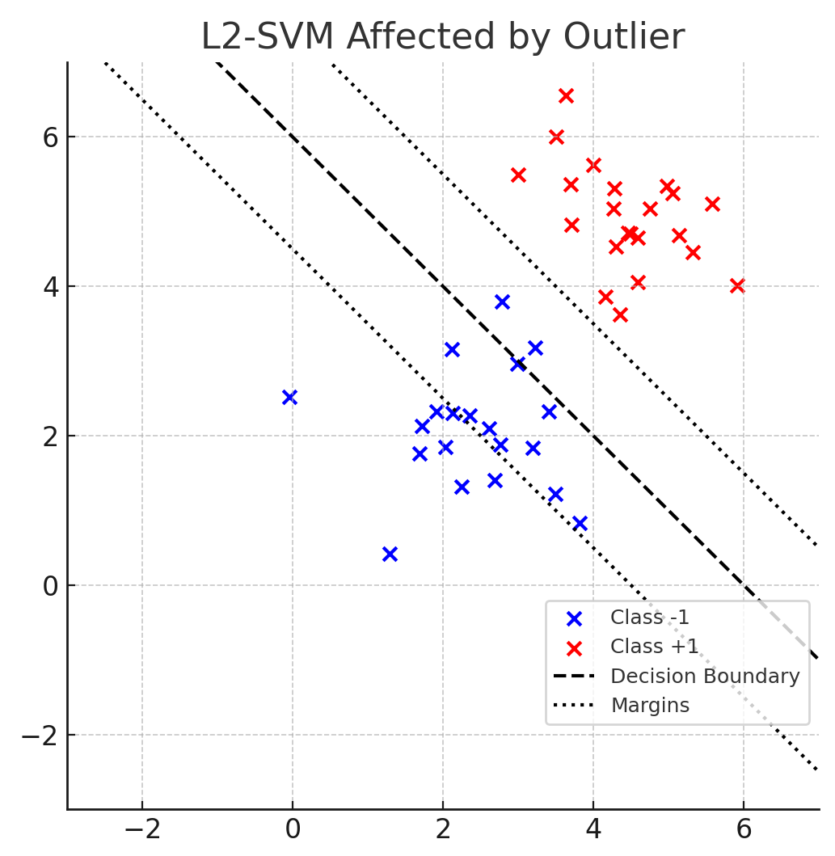

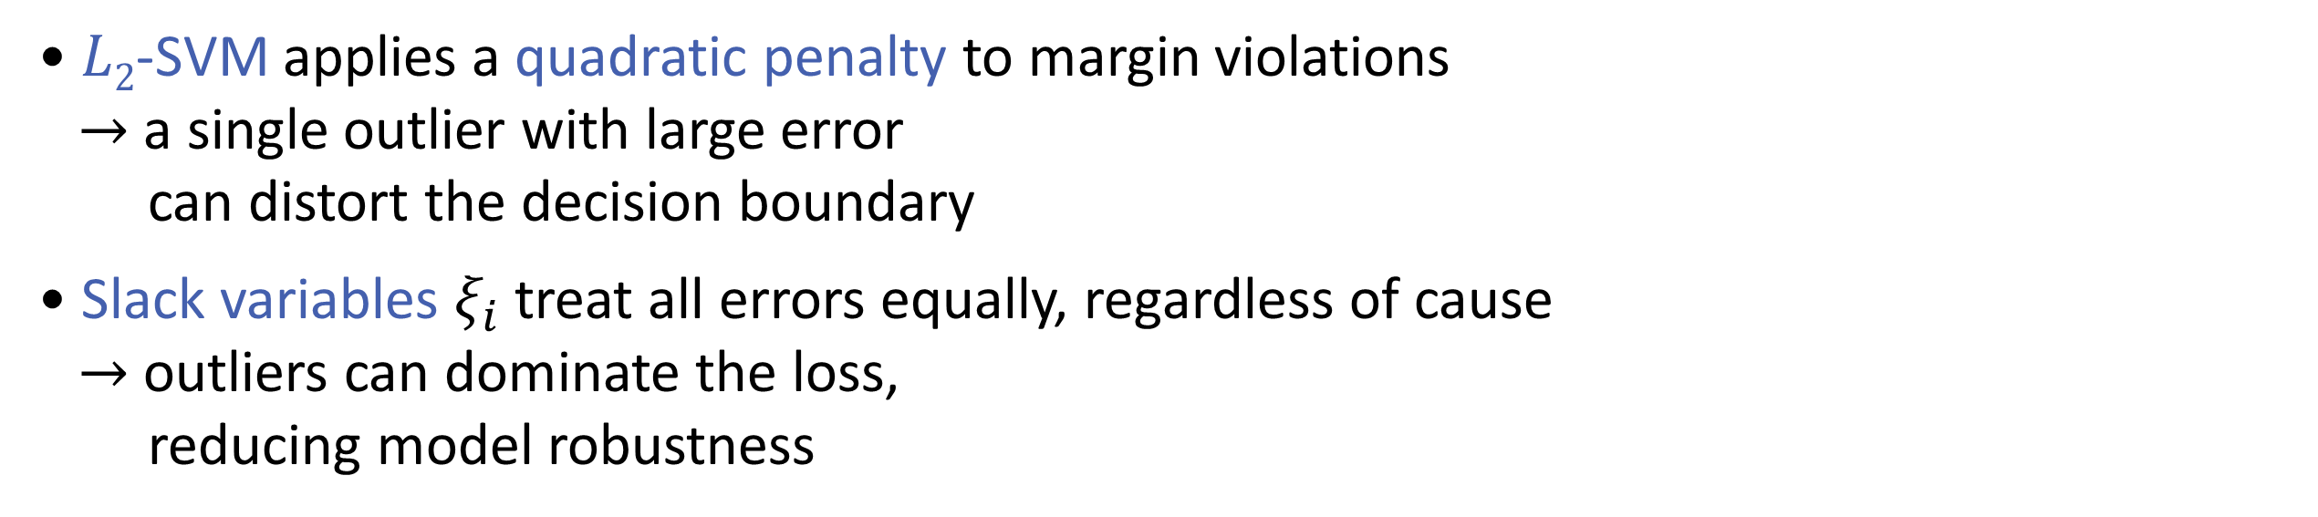
2. Limitations of Traditional SVMs
$L2$-SVM Limitations
• $L2$-SVM applies a quadratic penalty to margin violations
$→$ a single outlier with large error
can distort the decision boundary
• Slack variables $ξ_{i}$ treat all errors equally, regardless of cause
$→$ outliers can dominate the loss,
reducing model robustness
06

Slide 7
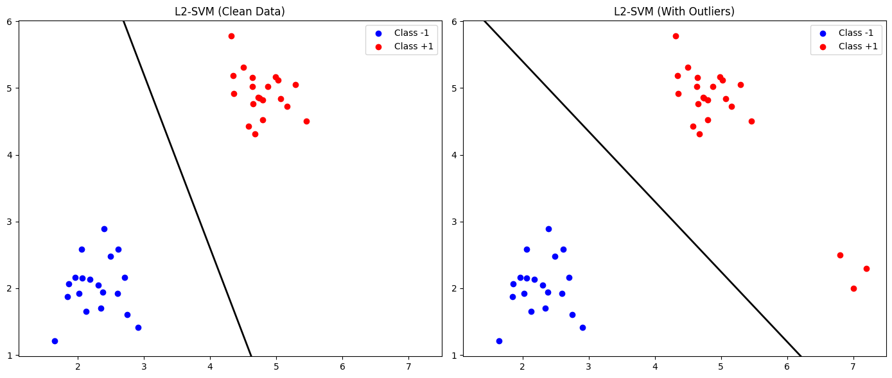

3. Motivation for Robust Methods
07

Slide 8
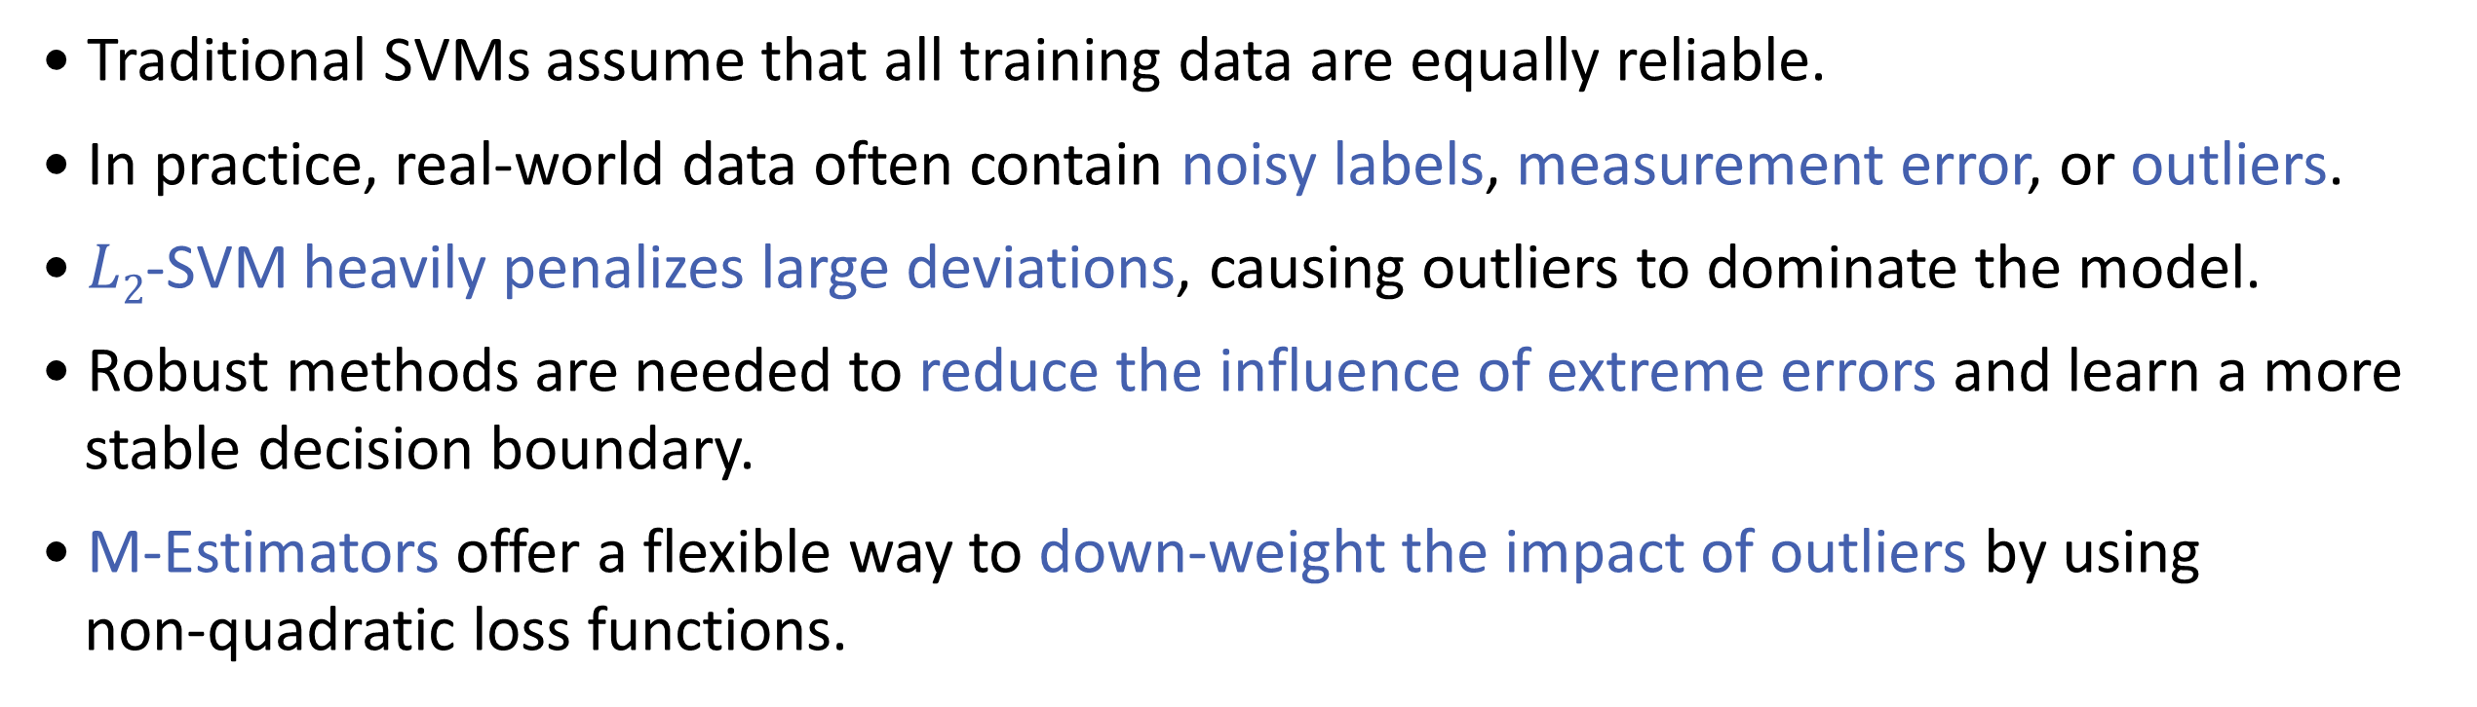
3. Motivation for Robust Methods
• Traditional SVMs assume that all training data are equally reliable.
• In practice, real-world data often contain noisy labels, measurement error, or outliers.
• $L2$-SVM heavily penalizes large deviations, causing outliers to dominate the model.
• Robust methods are needed to reduce the influence of extreme errors and learn a more
stable decision boundary.
• M-Estimators offer a flexible way to down-weight the impact of outliers by using
non-quadratic loss functions.
08

Slide 9
3. Limitations of $L1$-SVMs and $L2$-SVMs
The Importance for Robustness in SVM
• To address this limitation, our study proposes a framework that integrates M-estimation-
based loss functions.
09

Slide 10
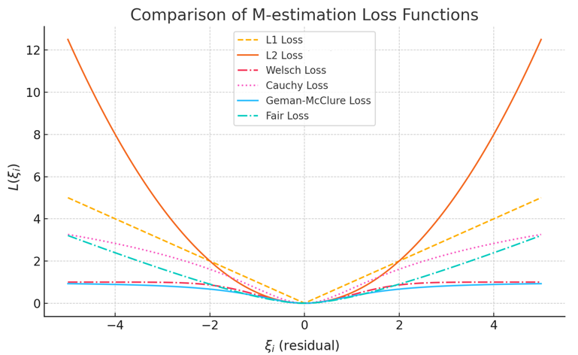
3. Limitations of $L1$-SVMs and $L2$-SVMs
The Importance for Robustness in SVM
• Unlike $L1$ and $L2$ loss, M-estimation loss suppress the impact of large errors, making the
model more robust to outliers.
10

Slide 11
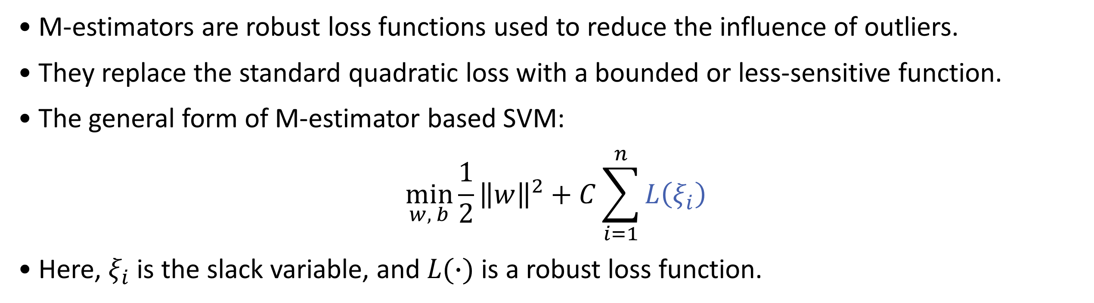
4. M-Estimator-based SVM
• M-estimators are robust loss functions used to reduce the influence of outliers.
• They replace the standard quadratic loss with a bounded or less-sensitive function.
• The general form of M-estimator based SVM:
$$\min_{w, b}\frac{1}{2}{\left\|w\right\|}^{2}+C\sum_{i=1}^{n}{L\left(ξ_{i}\right)}$$
• Here, $ξ_{i}$ is the slack variable, and $L(∙)$ is a robust loss function.
11

Slide 12
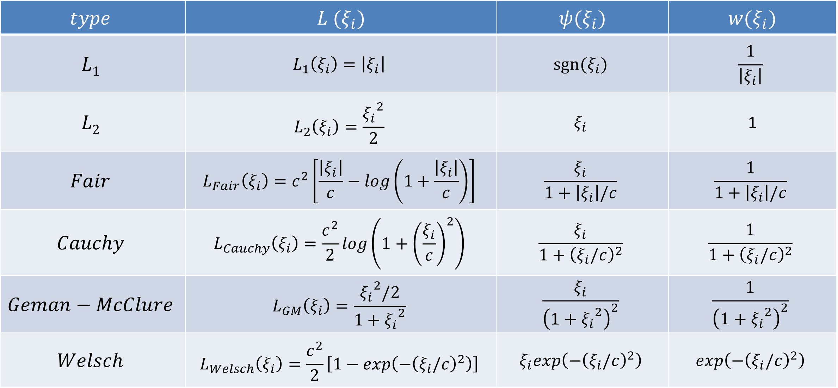
4. M-Estimator-based SVM
Some examples of common functions used in M-Estimators
$$type$$ | $$L (ξ_{i})$$ | $$ψ(ξ_{i})$$ | $$w(ξ_{i})$$
$$L1$$ | $$L_{1}\left(ξ_{i}\right)=\left|ξ_{i}\right|$$ | $$sgn⁡(ξ_{i})$$ | $$\frac{1}{\left|ξ_{i}\right|}$$
$$L2$$ | $$L_{2}\left(ξ_{i}\right)=\frac{{ξ_{i}}^{2}}{2}$$ | $$ξ_{i}$$ | 1
$$Fair$$ | $$L_{Fair}\left(ξ_{i}\right)=c^{2}\left[\frac{\left|ξ_{i}\right|}{c}−log\left(1+\frac{\left|ξ_{i}\right|}{c}\right)\right]$$ | $$\frac{ξ_{i}}{1+\left|ξ_{i}\right|/c}$$ | $$\frac{1}{1+\left|ξ_{i}\right|/c}$$
$$Cauchy$$ | $$L_{Cauchy}\left(ξ_{i}\right)=\frac{c^{2}}{2}log⁡\left(1+{\left(\frac{ξ_{i}}{c}\right)}^{2}\right)$$ | $$\frac{ξ_{i}}{1+{\left(ξ_{i}/c\right)}^{2}}$$ | $$\frac{1}{1+{\left(ξ_{i}/c\right)}^{2}}$$
$$Geman−McClure$$ | $$L_{GM}\left(ξ_{i}\right)=\frac{{ξ_{i}}^{2}/2}{1+{ξ_{i}}^{2}}$$ | $$\frac{ξ_{i}}{{\left(1+{ξ_{i}}^{2}\right)}^{2}}$$ | $$\frac{1}{{\left(1+{ξ_{i}}^{2}\right)}^{2}}$$
$$Welsch$$ | $$L_{Welsch}\left(ξ_{i}\right)=\frac{c^{2}}{2}\left[1−exp\left(−{\left(ξ_{i}/c\right)}^{2}\right)\right]$$ | $$ξ_{i}exp\left(−{\left(ξ_{i}/c\right)}^{2}\right)$$ | $$exp\left(−{\left(ξ_{i}/c\right)}^{2}\right)$$
12

Slide 13
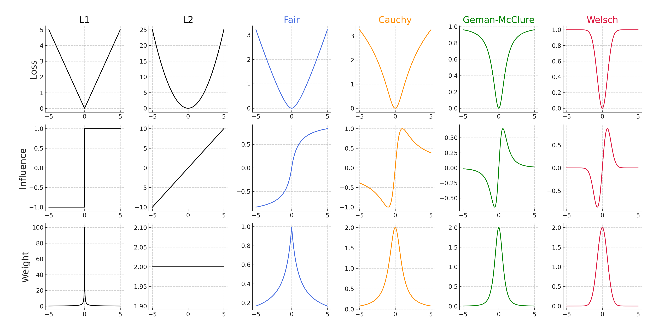


4. M-Estimator-based SVM
13

Slide 14
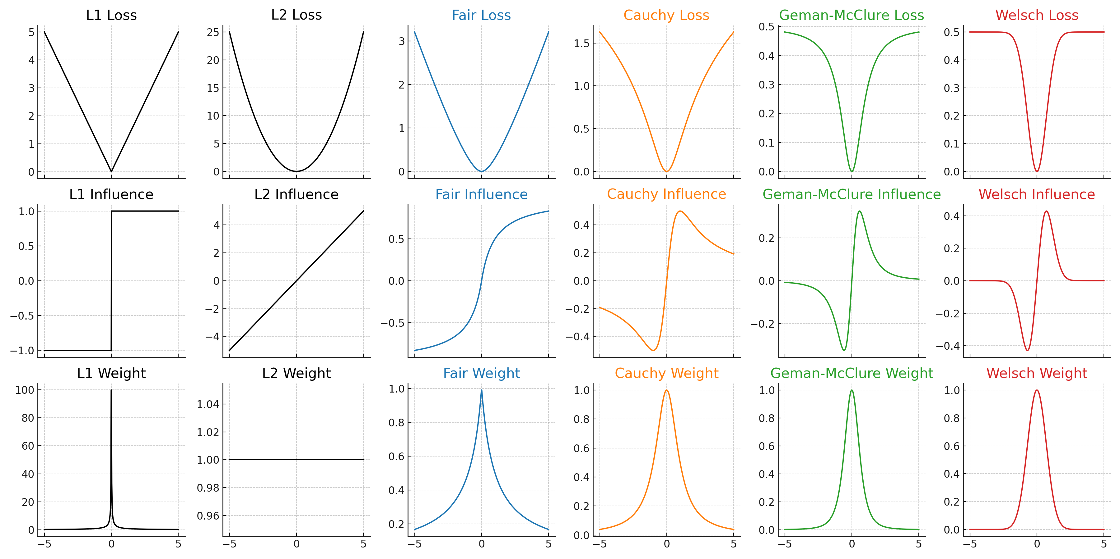
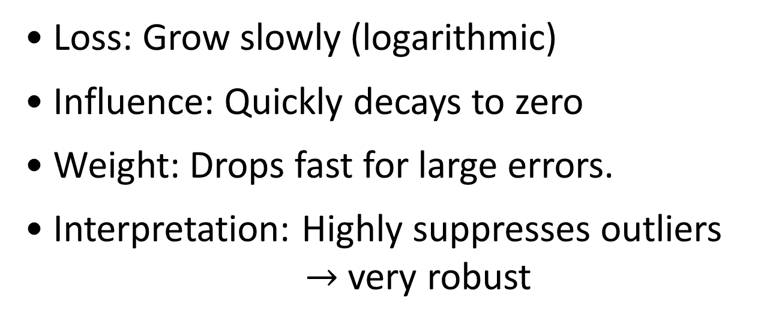
4. M-Estimator-based SVM
Type Fair SVM
Type Cauchy SVM
• Loss: Smoothly increases, grows slower.
• Influence: Linear near zero,
but saturates for large residuals.
• Weight: Decreases slowly in large residuals.
• Interpretation: Suppresses large errors,
sensitive to small ones.
• Loss: Grow slowly (logarithmic)
• Influence: Quickly decays to zero
• Weight: Drops fast for large errors.
• Interpretation: Highly suppresses outliers
$→$ very robust
14

Slide 15
4. M-Estimator-based SVM
Type Geman-McClure SVM
Type Welsch SVM
• Loss: Quadratic initially, then bounded
• Influence: Strong near zero, fades quickly
• Weight: Steep decline with residual
• Interpretation: Suppresses large errors,
limits outlier impact.
• Loss: Smooth and bounded,
flattens for large errors
• Influence: Sensitive only to moderate error
• Weight: Peaks at zero, fades rapidly
• Interpretation: Ignores outliers and
tiny noise, targets mid-level errors
15

Slide 16
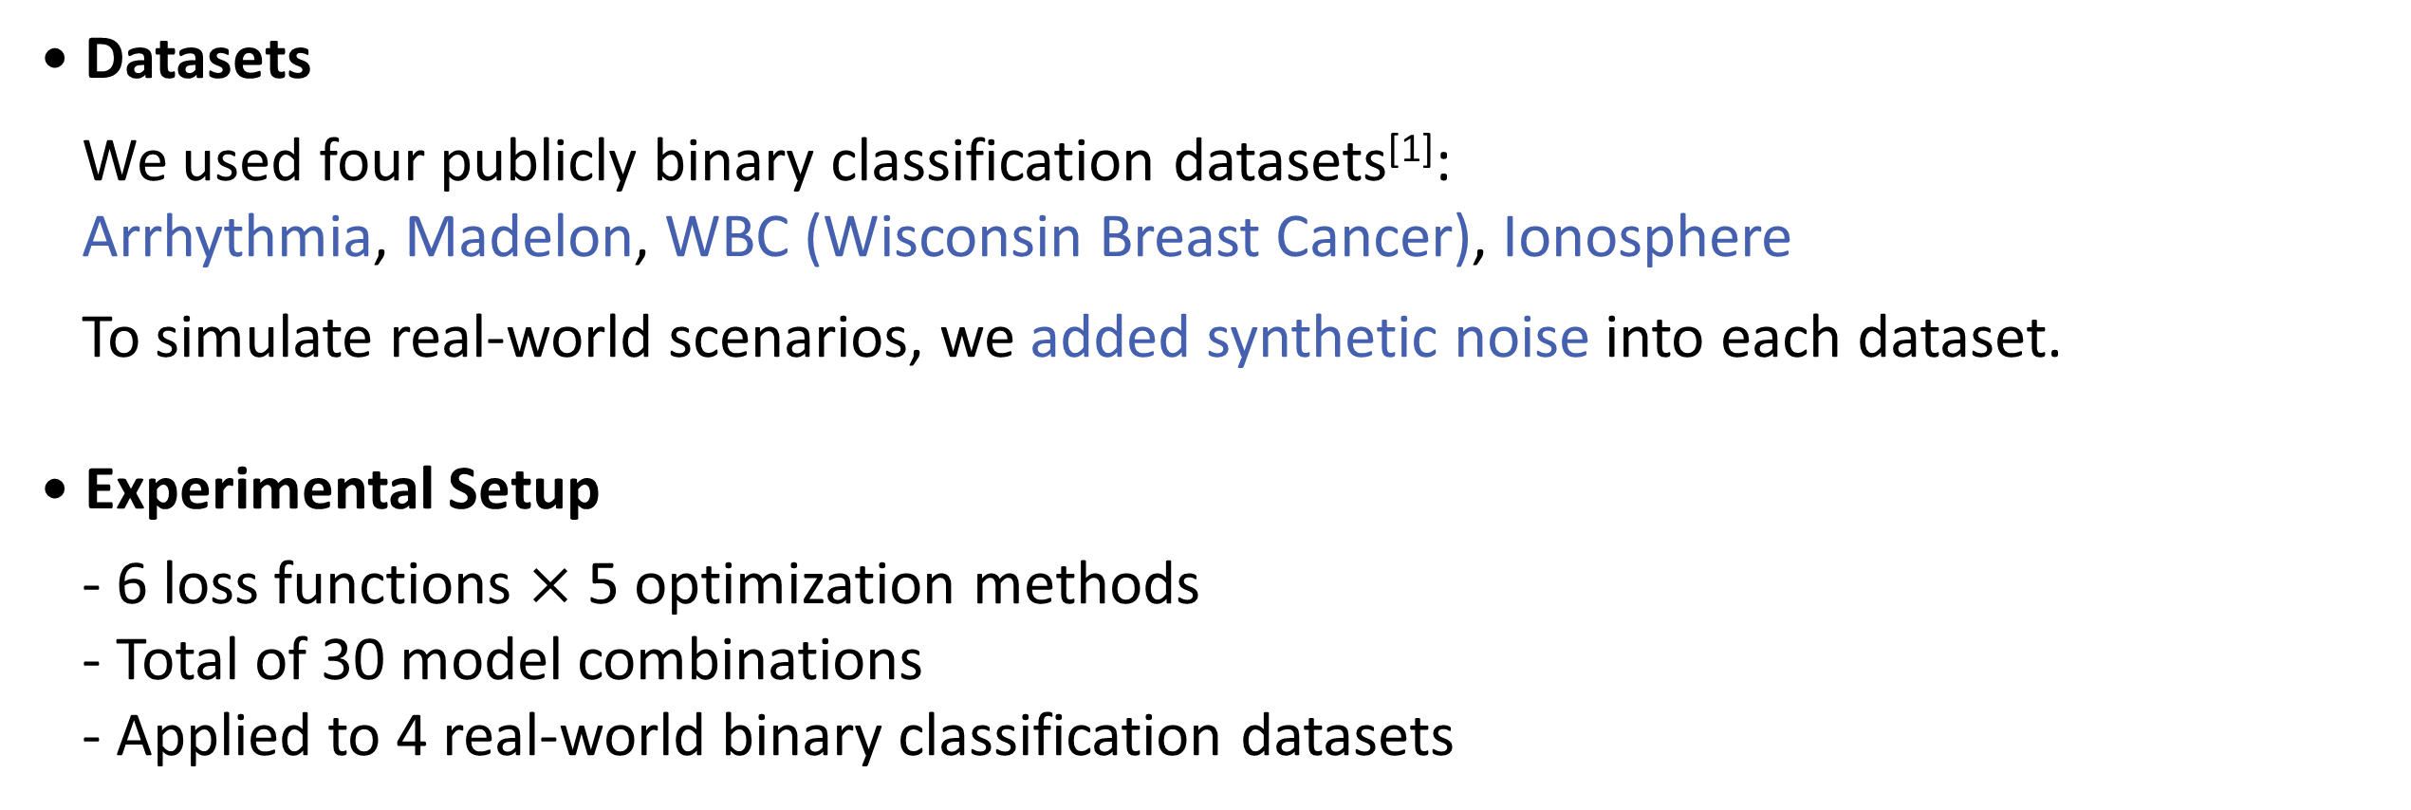
5. Data Analysis
• Datasets
We used four publicly binary classification datasets^{[1]}:
Arrhythmia, Madelon, WBC (Wisconsin Breast Cancer), Ionosphere
To simulate real-world scenarios, we added synthetic noise into each dataset.
• Experimental Setup
- 6 loss functions $×$ 5 optimization methods
- Total of 30 model combinations
- Applied to 4 real-world binary classification datasets
[1] https://archive.ics.uci.edu
16

Slide 17
5. Data Analysis
Optimization Methods Used:
• SMO (Sequential Minimal Optimization)
Traditional method for solving SVM’s quadratic problem efficiently.
• GA (Genetic Algorithm)
Evolutionary algorithm inspired by natural selection.
• PSO (Particle Swarm Optimization)
Population-based method inspired by the movement of bird flocks.
• ACO (Ant Colony Optimization)
Mimics ant foraging behavior to find optimal paths.
• HS (Harmony Search)
Inspired by musical improvisation, aiming to find a pleasing harmony (solution).
17

Slide 18
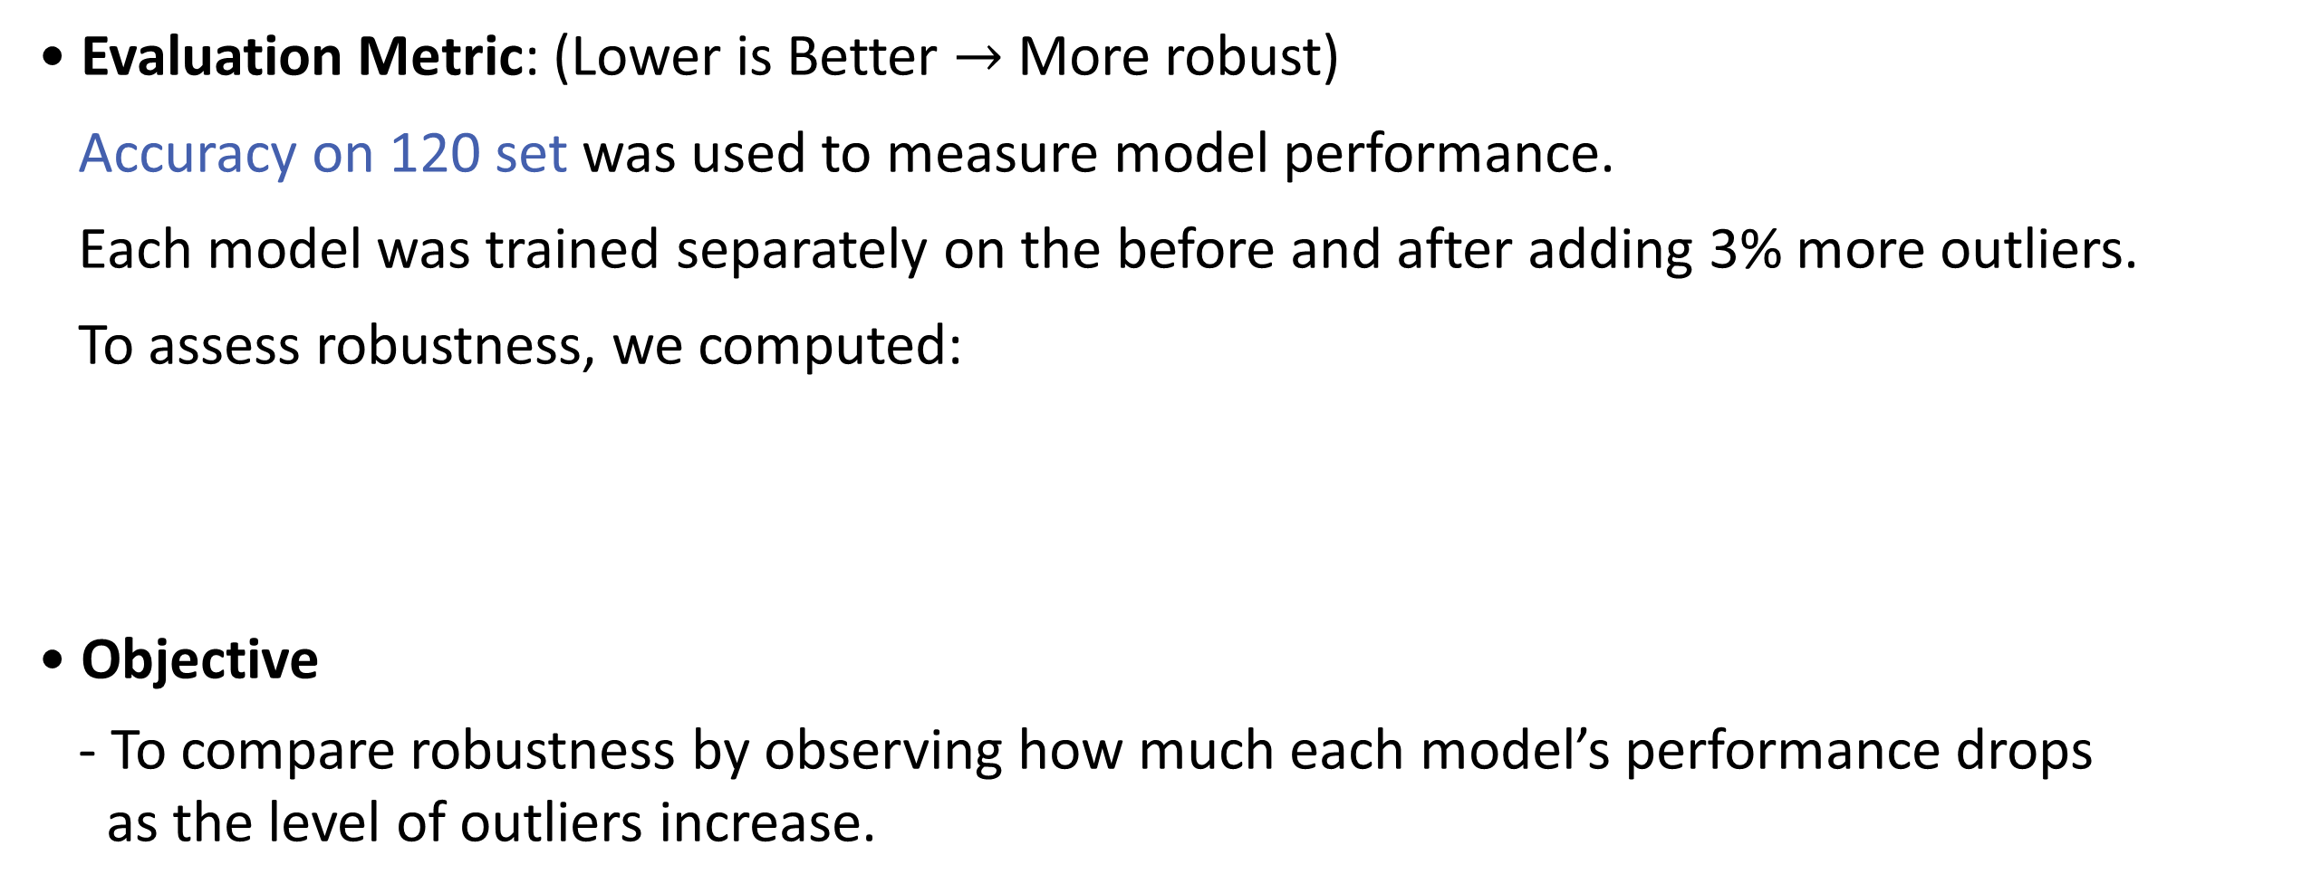
5. Data Analysis
• Evaluation Metric: (Lower is Better $→$ More robust)
Accuracy on 120 set was used to measure model performance.
Each model was trained separately on the before and after adding 3% more outliers.
To assess robustness, we computed:
• Objective
- To compare robustness by observing how much each model’s performance drops
as the level of outliers increase.
$$Accuracy drop=Accuracy\left(existing outliers\right)−Accuracy(adding 3\% outliers)$$
18

Slide 19
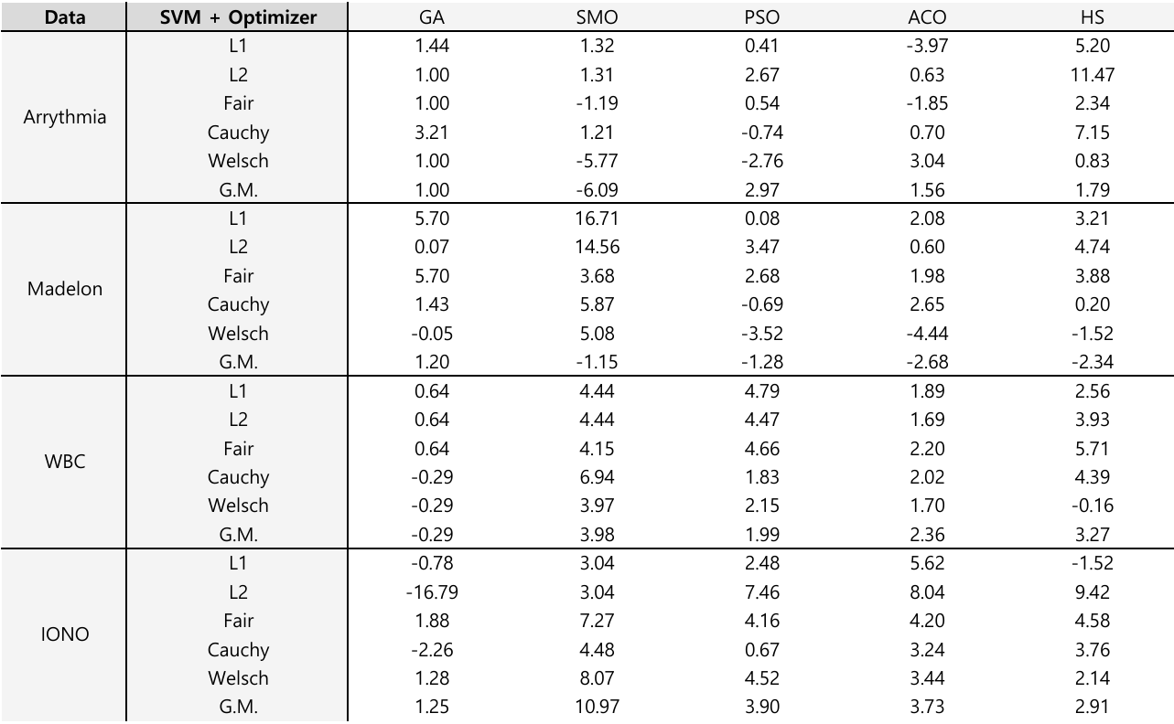
5. Data Analysis
19

Slide 20
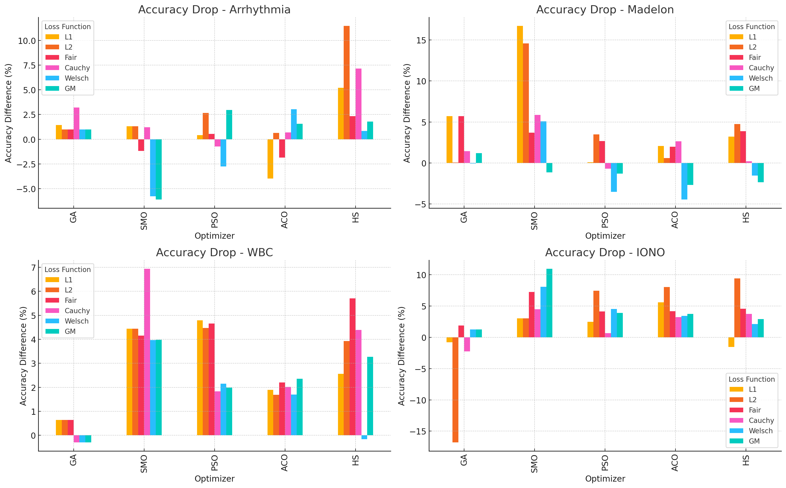
5. Data Analysis
20

Slide 21
5. Data Analysis
21

Slide 22
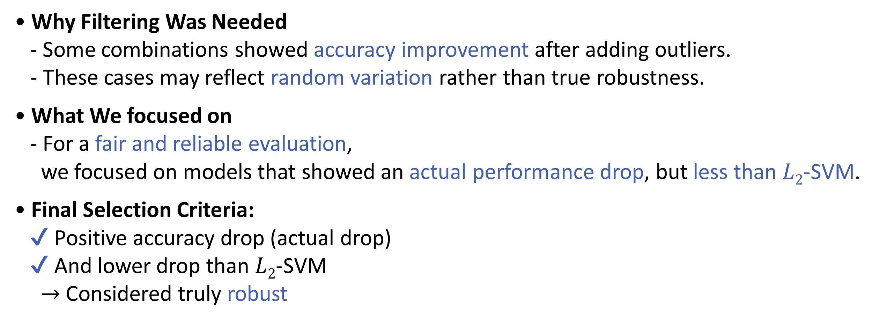
5. Data Analysis
• Why Filtering Was Needed
- Some combinations showed accuracy improvement after adding outliers.
- These cases may reflect random variation rather than true robustness.
• What We focused on
- For a fair and reliable evaluation,
we focused on models that showed an actual performance drop, but less than $L2$-SVM.
• Final Selection Criteria:
✔ Positive accuracy drop (actual drop)
✔ And lower drop than $L2$-SVM
$→$ Considered truly robust
22

Slide 23
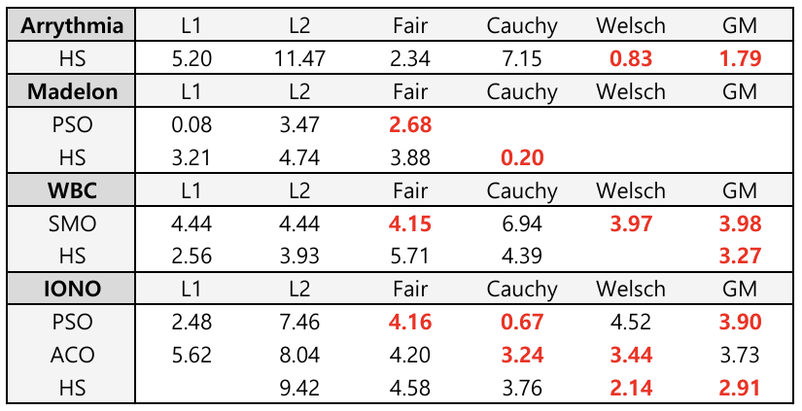
5. Data Analysis
Performance of Robust SVMs Compared to $L2$-SVM
23

Slide 24
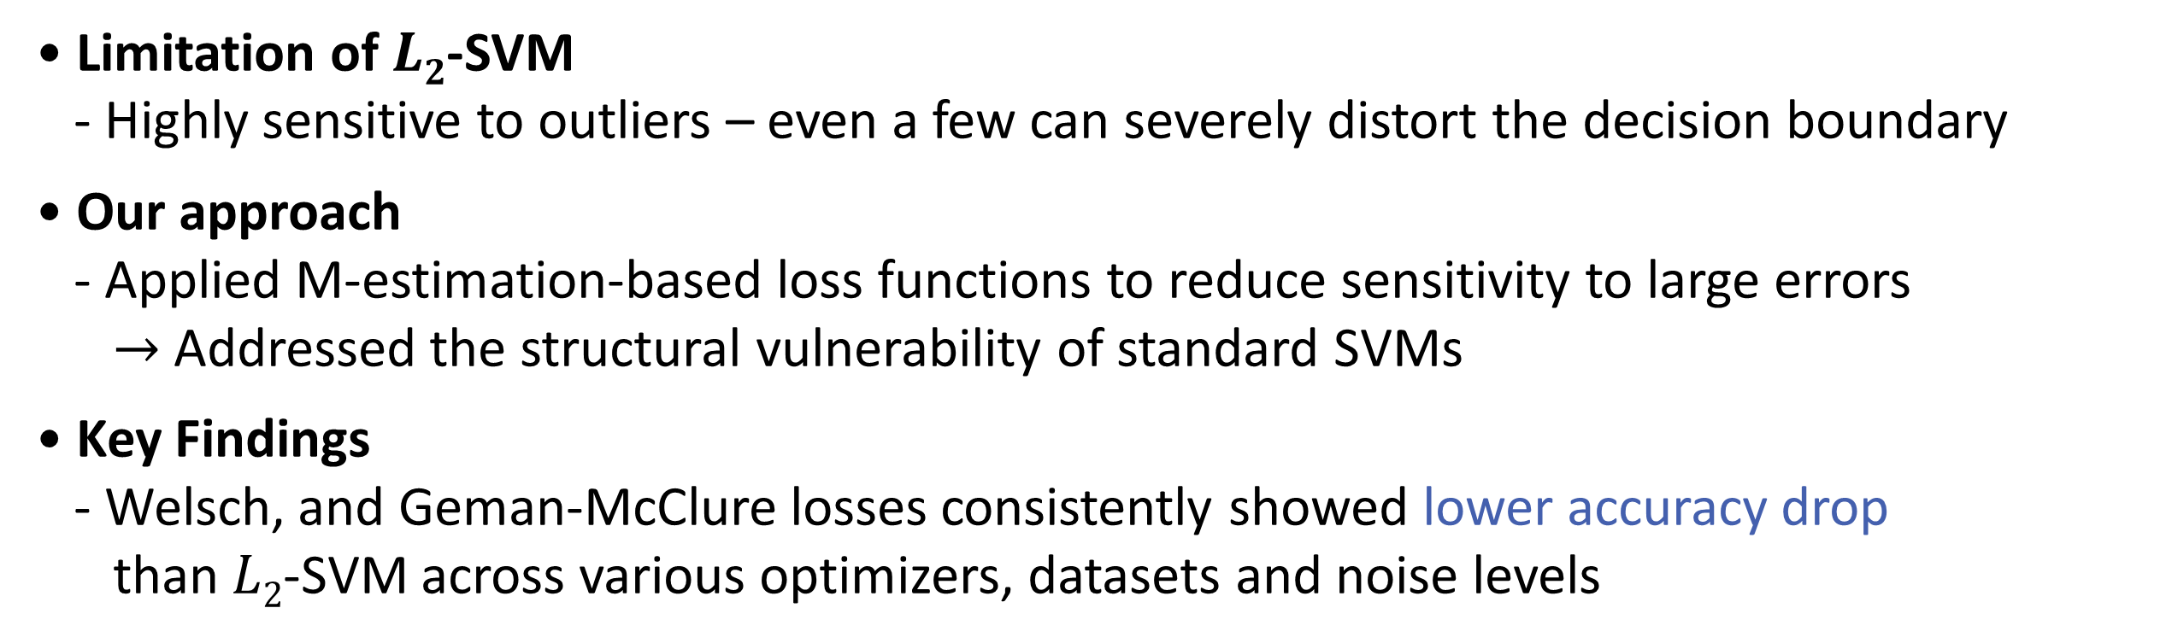
6. Conclusion
• Limitation of $L2$-SVM
- Highly sensitive to outliers – even a few can severely distort the decision boundary
• Our approach
- Applied M-estimation-based loss functions to reduce sensitivity to large errors
$→$ Addressed the structural vulnerability of standard SVMs
• Key Findings
- Welsch, and Geman-McClure losses consistently showed lower accuracy drop
than $L2$-SVM across various optimizers, datasets and noise levels
24

Slide 25
6. Conclusion
• Implication
- Proposed a robust learning framework that improves
the practical applicability of SVMs in noisy real-world conditions
• Future work
- Apply to real-world domains such as biomedical or financial data.
- Explore integration with Fuzzy SVMs, which allow for softer decision boundaries
and may improve robustness under uncertain or overlapping class regions.
25

Slide 26




Thank You
한국지능시스템학회 2025 춘계학술대회

